Slide 1
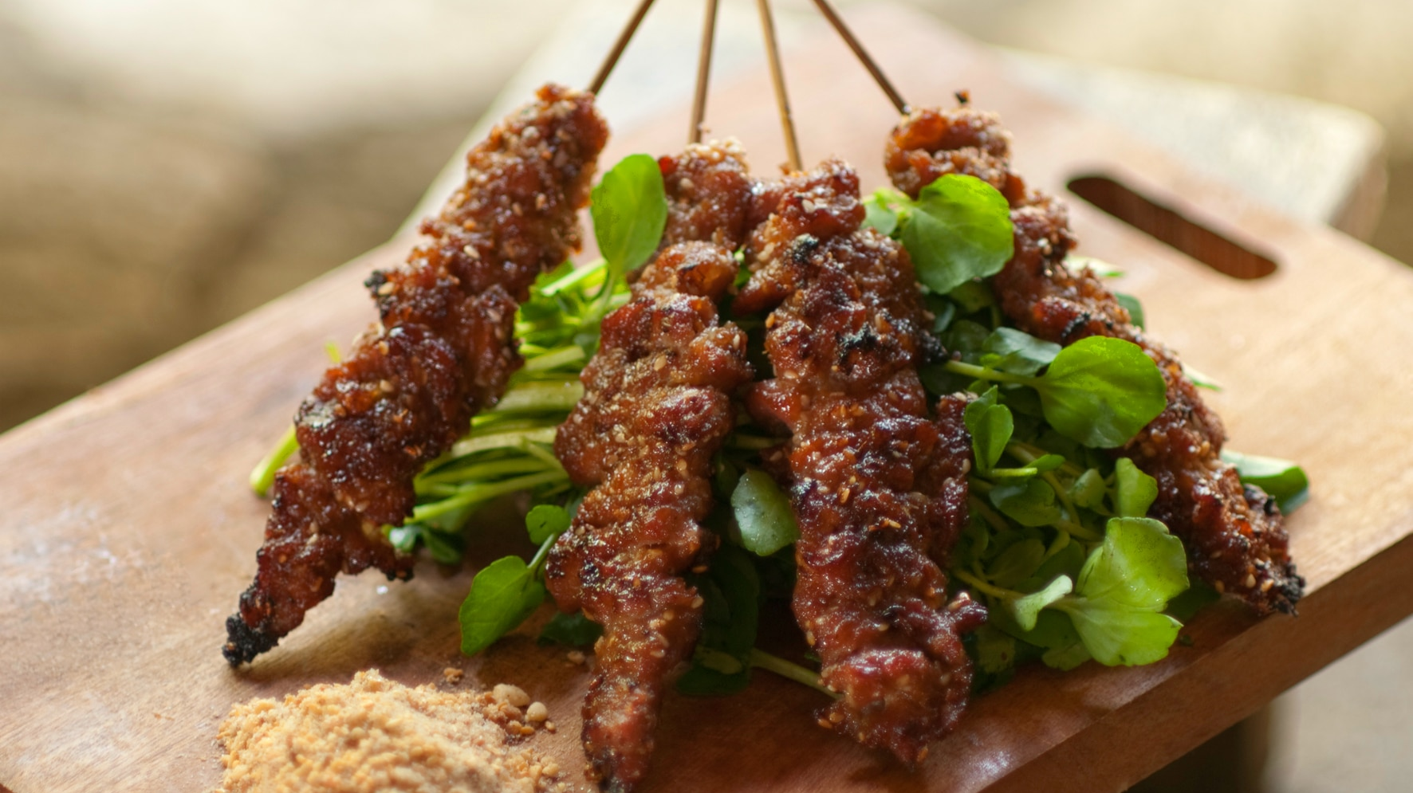
What’s For Dinner?
Notes:
Backstory:
I’ve always wanted to learn how to cook healthier fancy meals
But I never seem to have the time to cook a real meal because I am too busy or lazy
So I decided to use this project as an opportunity to stop asking ”whats for dinner” and start cooking

Slide 2
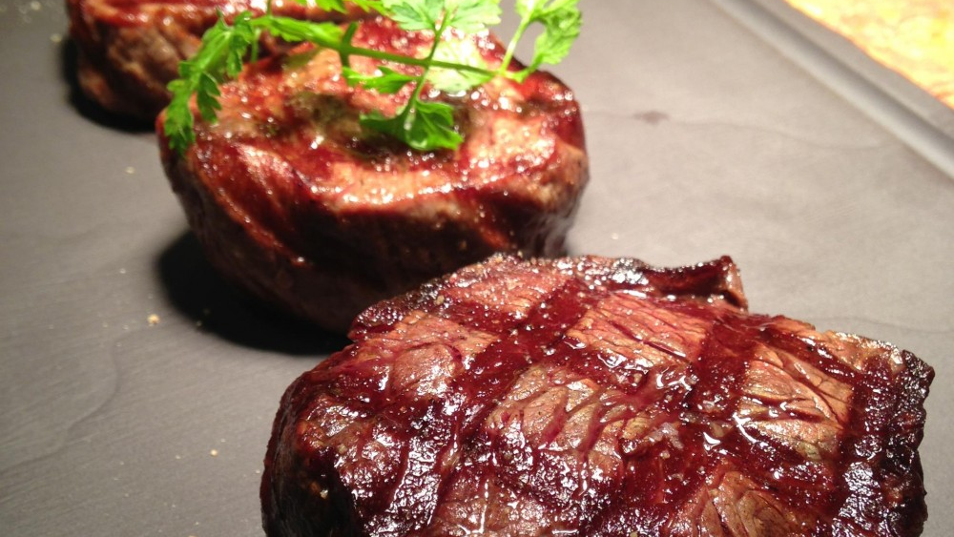
Objective
Find recipes that are quick and easy to make
Goals
Show topics identified via topic modeling
Identify new dishes for breakfast, lunch, dinner, and dessert
Notes:
Objective:
Because I do not have a lot of cooking experience I am not a very creative cook.
I am looking for up-scale recipes that are easier to make and have few ingredients (<10)
Goals:
Recommend quick and easy dishes that are healthy, because eating healthy is something that’s important to me:
low sodium
low fat
Low calories

Slide 3
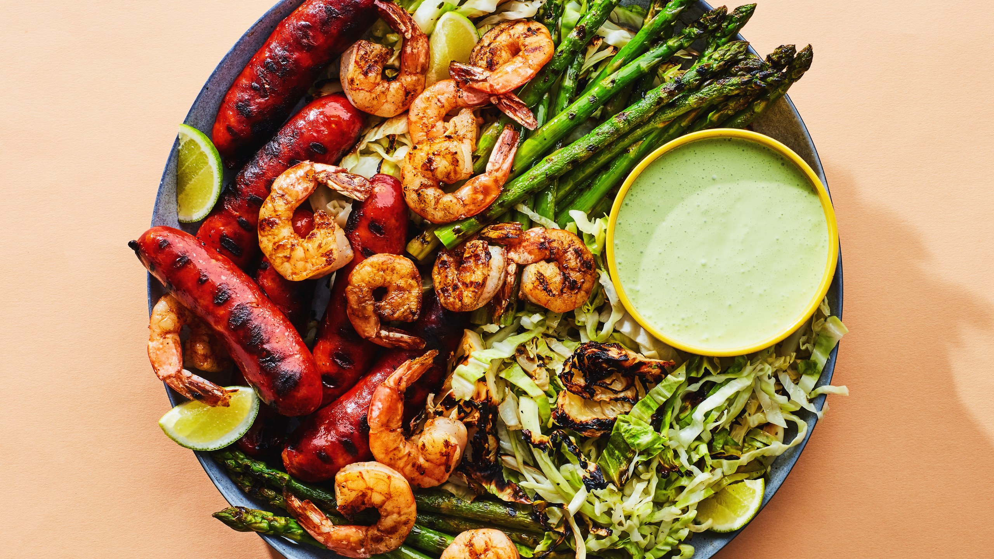
Epicurious Data
> 20,000 Recipes from Epicurious
Features:
Recipe Title
Ingredients
Directions
Rating
Etc.
Non-Negative Matrix Factorization Model
TF-iDF Vectorization
Notes:
FOR MY ANALYSIS:
Used over 20,000 recipes from Epicurious, which is a food resource for the average home cook
Modeling
For my model, I Fitted my text data to a bunch of different topic models but the best one in identifying topics was NMF
Using this model I was able to identify the three most common kind of recipes that most home cooks are interested in
These topics also giving me ideas of additional kinds of meals I could incorporate into my diet

Slide 4
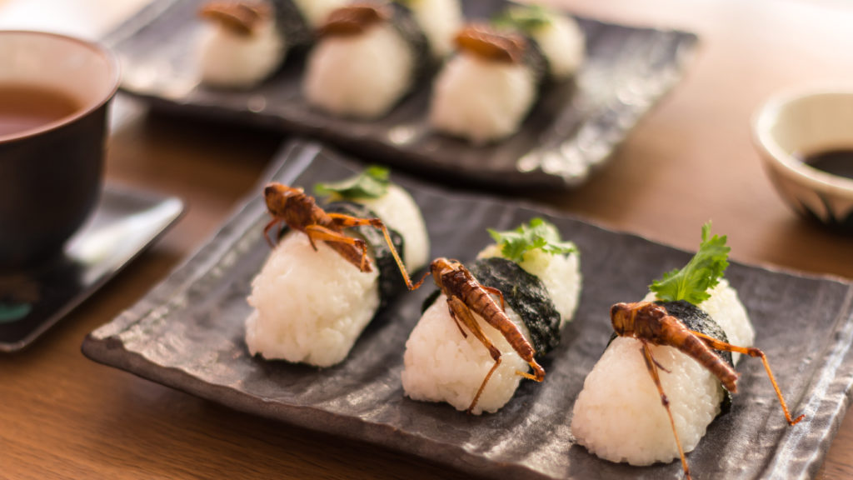
Yum
Chicken
Chicken
Roast Chicken
Grilled
Soup
Chicken Salad
Vegetarian
Salad
Cheese
Goat Cheese
Dressing
Tomato
Dessert
Chocolate
Cake
Ice Cream
Lemon
Sauce
Notes:
The first topic identified by my model is Chicken
I identified 3 major topics in my list of recipes, which told me what were the main kind of dishes that the typical home cook likes to make and ingredients that show up often in recipes
These three topics were:
Chicken
Dessert
Pork

Slide 5
Meal Recommendations
Breakfast: Berry Smoothie
Recommendation: Whole Wheat Pancakes with Bananas and Pecans
Lunch: Turkey Sandwich
Recommendation: Ham and Swiss Quiche
Notes:
Created a content based recommendation system that generated recipe recommendations based on my specified dietary requirements:
sodium
fat
calorie count
rating
the number of ingredients (quick) <10
AND All of the recommendations are based on dishes I currently eat often

Slide 6
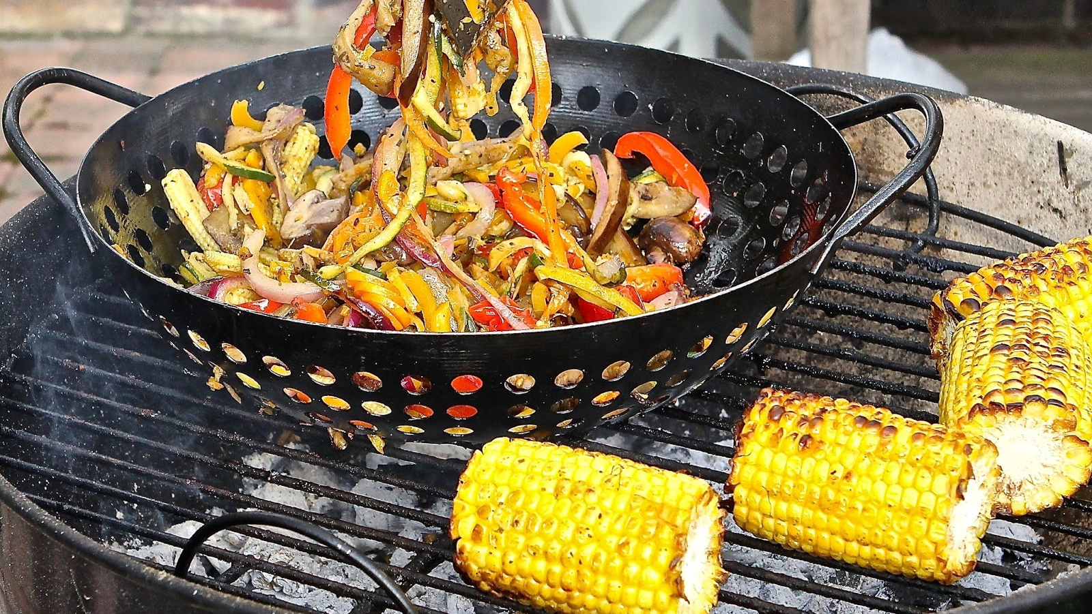
Meal Recommendations
Dinner: Salmon and Rice
Recommendation: Peppered Pork Tenderloin with Cherry Salsa
Dessert: Ice Cream
Recommendation: Chai-Poached Apricots and Plums
Notes:
- Now that I have all of tthese personal quick and easy recommendations, I can now make fancier dishes (i.e. Peppered Pork Tenderloin) that are easy and meet my dietary requirements.

Slide 7

Thank you!

